Slide 1
Automatic & Customized
Piano Fingering
Irina Lee

Slide 2
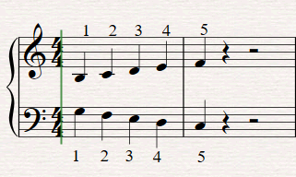
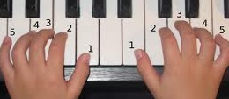
What is Piano Fingering
Written number guide
Numbers 1-5
Dynamics, articulation

Slide 3
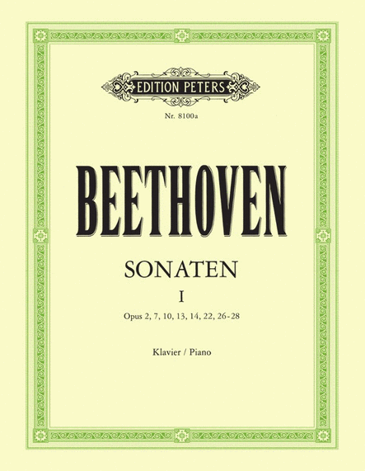
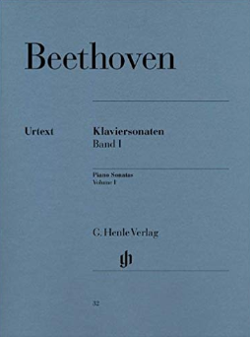
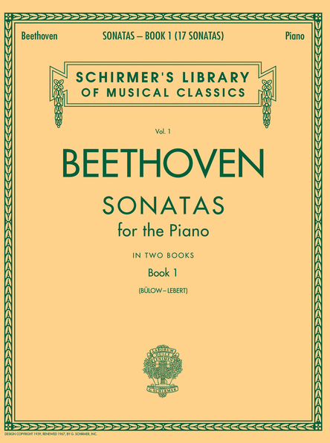
The Problem
No “one size fits all”
Differing hand spans
Lack of efficiency

Slide 4
The Proposal
Create an algorithm that outputs piano fingering tailored to a given hand size

